Slide 1


Student Ambassador Projects
Ambassador Projects : FreshSaver
Notes:
Korrie

Slide 2
Srapid Solution Type: Prototype, App/web
Names of Team Members : Abhijat Sarari
Notes:
Korrie

Slide 3
The Opportunity
FreshSaver is a web and mobile app that combats food waste and encourages sustainable food management practices. It has the following key features:
Food inventory management: Users can easily input their pantry, refrigerator, and freezer items, while AI algorithms track expiration dates and send timely reminders. Recipe suggestions: Personalized recipe ideas are generated based on available ingredients, promoting creative cooking and minimizing food waste. Local food bank integration: Users can schedule pickups for surplus food, contributing to local communities and reducing food waste. Gamified rewards: Earn points and badges for sustainable actions, such as donating food and participating in waste reduction challenges. Food waste analytics: Insightful data and visualizations help users monitor their consumption habits and progress in reducing waste.
I was inspired to create FreshSaver after learning about the global problem of food waste. Every year, one-third of all food produced for human consumption is lost or wasted. This is a staggering amount of food, and it has a significant impact on our environment.
I believe that FreshSaver can help to reduce food waste by making it easier for people to manage their food inventory and find creative ways to use up leftovers. I also hope that the gamified rewards system will encourage people to make sustainable food choices.
Notes:
Korrie
updated 7/21

Slide 4
Solution
Welcome to FreshSaver - an innovative web app designed to combat food waste and promote sustainable food management practices. This repository contains the released app prototype, providing you with an opportunity to explore its core features and functionalities.
Features
Food Inventory Management: Easily add and track items in your pantry, refrigerator, and freezer. AI algorithms will remind you of expiration dates to prevent food waste.
Recipe Suggestions: Get personalized recipe ideas based on the ingredients available in your inventory, encouraging creative cooking and reducing waste.
Local Food Bank Integration: Schedule pickups for surplus food items and contribute to your local community while minimizing waste.
Gamified Rewards: Earn points and badges for sustainable actions, such as donating food and participating in waste reduction challenges.
Food Waste Analytics: Gain insights into your consumption habits and progress in reducing waste through intuitive data visualizations.
Notes:
Korrie
updated 7/21

Slide 5
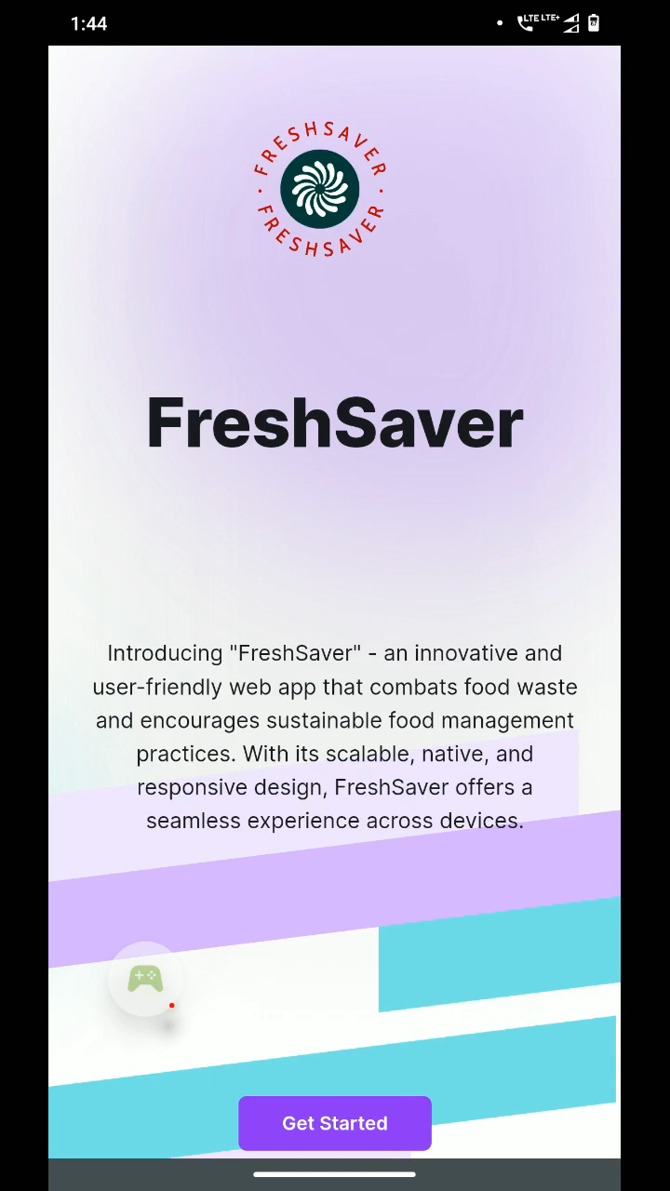
Demo
Notes:
Korrie
updated 7/21

Slide 6
Takeaways
How I built my project. : I built FreshSaver using a variety of technologies, including React, Node.js, Express, and AWS. I used React for the front-end development, Node.js for the back-end development, and Express to handle the routing and API calls.
The development process was challenging but rewarding. There were many times when I felt like giving up, but I persevered and eventually, I was able to create a product that I'm proud of.
Challenges I faced : One of the biggest challenges I faced was finding the time to develop FreshSaver. I was working full-time at a job, and I was also taking classes at night. I had to sacrifice a lot of my free time to work on the project, but I was determined to see it through.
Another challenge I faced was finding the right team members. I wanted to build a team of people who were passionate about the problem of food waste and who were willing to work hard to make FreshSaver a success. I was lucky enough to find a team of amazing people who shared my vision, and I'm grateful for their contributions to the project.
Next steps : I'm excited to continue developing FreshSaver and to make it even more helpful for people who are trying to reduce food waste. I'm planning to add new features, such as the ability to create meal plans and to track food waste over time. I'm also planning to make the app more accessible to people in different countries.
Notes:
Korrie
updated 7/21

